Slide 1
Introduction to Container Technology
Application Modernization Series
Chatchai Kongmanee
Specialist Solution Architect
Red Hat, Thailand

Slide 2
Application Modernization Series
Roadmap
Introduction to Container
DevOps and CI/CD
What & Why Container?
Docker
Demo: Build App & DB with Docker
DevOps and CI/CD Concept
Everything as-a-Code
Demo: Build and Deploy with CI/CD Tool
Session 4
25 Mar 2021 15:00
(45 mins - 1 hour)
Session 2
11 Mar 2021 15:00
(45 mins - 1 hour)
Session 1
4 Mar 2021 15:00
(45 mins - 1 hour)
Session 3
18 Mar 2021 15:00
(45 mins - 1 hour)
Application Modernization
Introduction to Container Orchestration Platform
How to containerize existing App?
Demo: Application Migration Tool, New Framework for Container
What & Why Container Orchestration Platform?
Basic concept of Application Deployment on Container Orchestration Platform with Demo

Slide 3
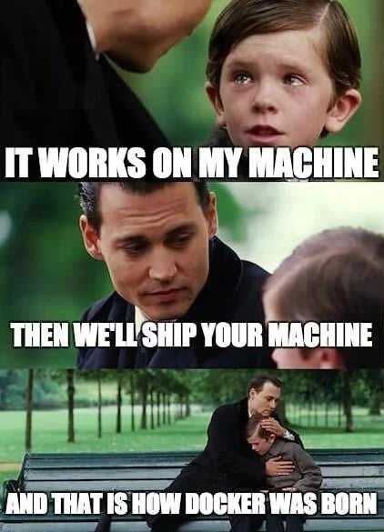
The Problem
Background
Notes:
Developers have different motivations and concerns than the IT Operations. Developer's job is to deliver a change and care about new frameworks, architectures and tools to do so, while IT Operations’ job is to bring stability and care about environment predictability, lifecycle management, security, costs and monitoring. As a result, applications are designed and developed in accordance to Developers mindset and Operations requirements are layered over it at later stages of delivery, leading to frustrating frictions specially in the end of each delivery cycle.

Slide 4
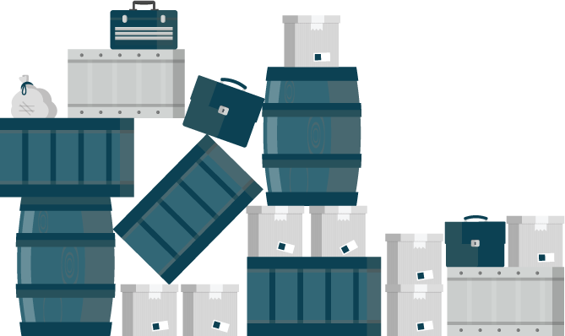






Background
The Problem
Applications require complicated installation and integration every time they are deployed
LAPTOP
BARE METAL
VIRTUALIZATION
PRIVATE CLOUD
PUBLIC CLOUD
Notes:
Due to deployment, configuration and integration inconsistency between applications, delivering an application into production is a non-trivial task with lots of friction and many back-and-forth cycles between Developers and IT Operations. Painful deployments leads to not only poor quality of the delivered service but also to a tendency to avoid the pain by deploying to production as seldom as possible. This in turn, results in larger deployments with more features being delivered at once and higher risk of things going wrong, which results in more pain, fewer deployments, … and story goes on.

Slide 5
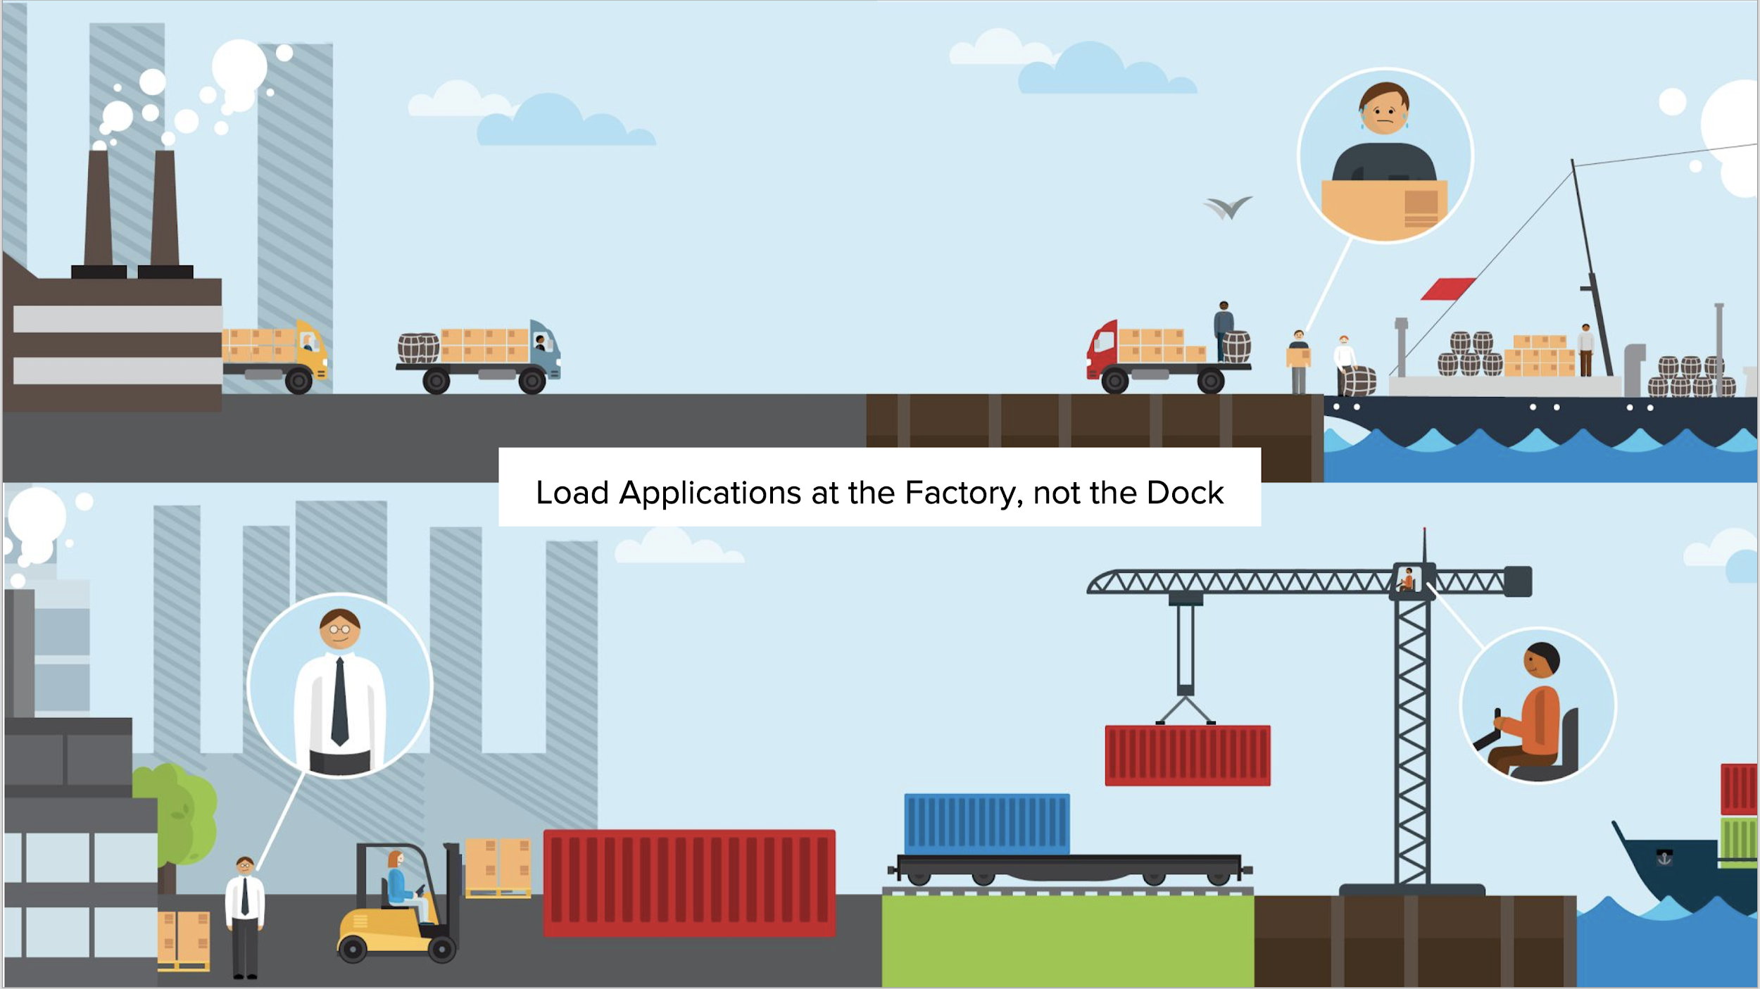
Background
Load Applications at the Factory, not the Dock

Slide 6
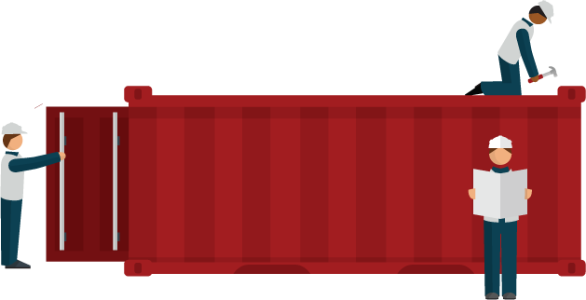
Background
The Solution
Adopting a container strategy will allow applications to be easily shared and deployed.
Setup Once, Run Anywhere!
Notes:
DevOps only took off when containers gained popularity and significantly simplified the automation that DevOps advocates.
Containers provide consistent environment and tools for both Developers and Operations to package, delivery and manage the applications and therefore simplify the deployment process regardless of how the application looks like and the frameworks Developers have used to build the application. They also provide a common set of building blocks that can be reused in any stage of development to recreate identical environments for development, testing, staging, and production, extending the idea of write once; deploy anywhere

Slide 7

What are Containers?
Background
It depends who you ask...
INFRASTRUCTURE
APPLICATIONS
Sandboxed application processes on a shared Linux OS kernel
Simpler, lighter, and denser than virtual machines
Portable across different environments
Package my application and all of its dependencies
Deploy to any environment in seconds and enable CI/CD
Easily access and share containerized components
Notes:
But what are containers? The answer depends who you ask. From an infrastructure perspective, containers rely on Linux operating system features like control groups, kernel namespaces and SELinux to isolate slices of the underlying operating system. Each container has some libraries from Linux operating system inside it. They are simple to build and run and consume less resources compared to virtual machines. This enables us to run many containers on the same infrastructure and increase utilisation. While container provide many benefits for infrastructure, they also pose complexities that need orchestration and management to be used effectively.
From an application perspective, container is a way to package an enterprise application in a self-contained artifact. It is easy to package applications that are already built and simple to share those apps across the organization. Developers have full control over the content of a container and can package everything that an application needs for running, inside the container.

Slide 8
VIRTUAL MACHINES AND CONTAINERS
VIRTUAL MACHINES
CONTAINERS
VM
Container
Container
Container
Container
App
App
App
App
App
App
App
App
OS Dependencies
OS deps
OS deps
OS deps
OS deps
Kernel
Container Host (Kernel)
Hypervisor
Hypervisor
Hardware
Hardware
VM isolates the hardware
Container isolates the process
Notes:
Organizations have traditionally co-located multiple applications on a single virtual machines due to the operational overhead and resource costs of maintaining VMs.
Although VMs are isolated from each other however co-located applications have zero isolation and can negatively impact each other files, configurations and behaviour.
Linux containers share a container host and kernel and at the same time using kernel technologies such as cgroups, SELinux and kernel namespaces provide isolation so that one container cannot access or impact neither the other containers running on the same host nor the host itself.
Linux containers are in a way a virtualization technology. VMs are for virtualizing the hardware while containers are for virtualizing application processes no matter where they run (bare metal, virtualized or cloud)

Slide 9
VIRTUAL MACHINES AND CONTAINERS
Virtual Machine
Container
Application
Application
OS dependencies
OS dependencies
Operating System
Container Host
VM Isolation
Complete OS
Static Compute
Static Memory
High Resource Usage
Container Isolation
Shared Kernel
Burstable Compute
Burstable Memory
Low Resource Usage
Notes:
Although possible to run every application on a single virtual machine, the operational overhead and resource cost of the multitude of extra VMs required generally invalidates the perceived benefits
Virtual machines have the advantage of providing hypervisor-level isolation for the application. However that comes at the cost of running a complete operating system for each application which consumes more memory and cpu. Furthermore, VMs compute and memory capacity is pre-defined and do not provide any elasticity or bursting more when an application requires more memory or computing power.
Containers provide isolation through taking advantage of kernel technologies like cgroups, kernel namespaces and SELinux which have been battle-tested and used for years at Google and US Department of Defense to provide application isolation
Since containers use a shared kernel and container host, they reduce the amount of resources required for the container itself and are more lightweight than virtual machines. Therefore, containers provide an unmatched agility that is not feasible with virtual machines for example it only takes a few seconds to start a new container. Furthermore, containers support a more flexible model when it comes to compute and memory resources and allow resource burst modes so that applications can consume more resources when required within the defined boundaries.

Slide 10
VIRTUAL MACHINES AND CONTAINERS
Virtual Machine
Container
Application
Clear ownership boundary between Dev and IT Ops drives DevOps adoption and fosters agility
Application
Dev
IT Ops (and Dev, sort of)
OS dependencies
OS dependencies
Operating System
Container Host
IT Ops
Infrastructure
Infrastructure
Optimized for stability
Optimized for agility
Notes:
DevOps adoption skyrocketed in the last few years which coincides with the proliferation containers in the IT industry. This in fact is not a coincidence and containers have played an important role in enabling organizations to implement DevOps without the obstacles once faced with virtual machines.
With virtual machines being the unit of compute, applications are developed by Dev teams and the result is delivered as arbitrary packages (which usually varies between teams and applications) to the IT Ops teams which are responsible for building, deploying and managing the virtual machine, operating system, libraries and application dependencies and the application itself. This essentially creates a conflictory atmosphere between Dev, IT Ops and other teams involved in delivering applications since IT Ops is forced into ownership of undocumented and non-standard layers of the technology stack (in other words the application and its dependencies) that they are not familiar with and have to rely on vague instructions from the Dev teams.
When containers are used as a unit of compute, there is a clear boundary between the layers of technology stack that IT Ops and Dev teams own and manage. Dev teams are deeply familiar with the application they build as well as its dependencies and configurations. With containers, they own the application and its configuration and package the result as a container image. The container images are delivered to IT Ops as a standard package regardless of the technologies used to build the application. IT Ops owns the entire infrastructure (container host, virtualisation, etc) for running standard container images and can deploy, monitor and manage containers across multiple infrastructure using standard procedures without the need for adaptation for every application.
Using containers, Dev and IT Ops teams can work at different speeds, upgrade and downgrade servers and applications independently of each other, and easily move applications between different environments.
The clear ownership boundary allows Dev and IT Ops to work seamlessly during the application delivery cycles and lays the ground for enabling DevOps across organizations.

Slide 11
APPLICATION PORTABILITY WITH VM
Virtual machines are NOT portable across hypervisor and do NOT provide portable packaging for applications
Guest VM
VM Type X
VM Type Y
VM Type Z
Application
Application
Application
Application
Application
OS dependencies
OS dependencies
OS dependencies
OS dependencies
OS dependencies
Operating System
Operating System
Operating System
Operating System
Operating System
LAPTOP
BARE METAL
VIRTUALIZATION
PRIVATE CLOUD
PUBLIC CLOUD
Notes:
Although there has been efforts to standardize the virtual machine format, it never succeeded and the virtual machine technology is highly tied to the hypervisor. For example when using VMware, the VMs on-premise are tied to vSphere whereas in a public cloud such as Amazon Web Services they are tied to AWS hypervisors.
Moving an application to other infrastructure such as bare metal, other hypervisors, private and public clouds would require rebuilding the applications technology stack from scratch based on the chosen infrastructure and redoing all verifications on the previous infrastructure.
The industry is going toward immutable infrastructure to simplify deployment and management of software. Using VMs as the packaging unit for applications, requires you to build a new VM every time that there is a change and ship that to your infrastructure. Netflix is the best example of this approach. When they needed to make a change in production, they had to bake that change in a new VM (AWS AMI) and ship the VM to production. Interestingly Netflix states that they would have taken a different approach, had linux containers ecosystem at that time been as mature as it is today.

Slide 12
APPLICATION PORTABILITY WITH CONTAINERS
RHEL Containers + RHEL Host = Guaranteed Portability Across Any Infrastructure
Container
Container
Container
Container
Container
Application
Application
Application
Application
Application
OS dependencies
OS dependencies
OS dependencies
OS dependencies
OS dependencies
RHEL
RHEL
RHEL
RHEL
RHEL
Guest VM
Virtual Machine
Virtual Machine
Virtual Machine
LAPTOP
BARE METAL
VIRTUALIZATION
PRIVATE CLOUD
PUBLIC CLOUD
The Open Containers Initiative (OCI) Runtime Standard
Notes:
Container provide application portability due to the standard image format (Open Container Initiative) and the fact that they are only dependent on Linux. This gives teams better control over the infrastructure where they deploy applications. A container host provides a common ground for running containers on any infrastructure from your own laptop, to bare metal, virtualization, private and public clouds.
Nevertheless, portability does not guarantee compatibility. Portability is often believed to mean that you can take a container image and run it on any container host built from any Linux distribution, but this is not technically accurate. Linux container images are collections of files, including libraries and binaries, which are specific to the hardware architecture and operating system. When the container image is run, the binaries inside the image run just like they would on a normal Linux operating system. There must be compatibility between the container image and container host. For example, you cannot run 64-bit binaries on a 32-bit host.
These inconsistencies can range from sporadic failure, which is hard to debug, to complete failure where the container will not run at all. Worse, incompatibilities can lead to performance degradation or security issues. Portability of Linux containers is not absolute—using different Linux distributions, or widely differing versions of the same Linux distribution, can lead to serious problems.
In order to guarantee portability and compatibility, it is a best practice to run a consistent version and distribution of Linux in all containers and on all container hosts across environments and infrastructure. This guarantees compatibility both horizontally and vertically.
OCI-standard containers combined with the a standard container host like Red Hat Enterprise Linux provides a portable and compatible application delivery combination that guarantees your applications run the exact same way across all environments and infrastructure.
Immutability is also one of the key benefits of OCI standard container images without being tied to a specific machine image format like you are with VM images such as AMI on AWS. That’s why you see even Netflix adopting containers to enable the same CD workflows but now in a more portable and efficient manner.

Slide 13
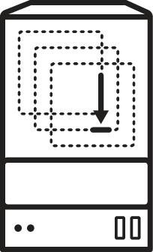
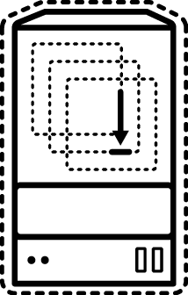


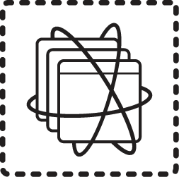

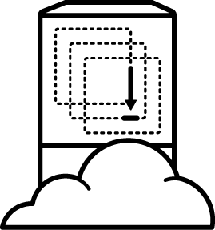
DEVOPS WITH CONTAINERS
physical
virtual
private cloud
dev
source repository
CI/CD engine
container
public cloud
Notes:
How does a deployment pipeline look like with containers? It all begins with a developer committing a change to the source repository. The CI/CD engine (e.g. Jenkins) gets notified, downloads the application code from source repository and rebuilds the application with the new change. Introducing containers, the CI/CD engine at this stage will package the application as a container image which can be deployed on the target environment and runs the exact same way regardless of if it’s physical, virtual, private or public cloud infrastructure.

Slide 14



Container benefits across teams
App Developers
Faster, more consistent deployments
Better application scalability
Better application isolation
I.T. Architects
Faster scale out
Shorter test cycles
Fewer deployment errors
I.T. Operations
Higher quality releases
Efficient replacement of full virtual machines in production
Easier application management
Notes:
DevOps adoption skyrocketed in the last few years which coincides with the proliferation containers in the IT industry. This in fact is not a coincidence and containers have played an important role in enabling organizations to implement DevOps without the obstacles once faced with virtual machines.
With virtual machines being the unit of compute, applications are developed by Dev teams and the result is delivered as arbitrary packages (which usually varies between teams and applications) to the IT Ops teams which are responsible for building, deploying and managing the virtual machine, operating system, libraries and application dependencies and the application itself. This essentially creates a conflictory atmosphere between Dev, IT Ops and other teams involved in delivering applications since IT Ops is forced into ownership of undocumented and non-standard layers of the technology stack (in other words the application and its dependencies) that they are not familiar with and have to rely on vague instructions from the Dev teams.
When containers are used as a unit of compute, there is a clear boundary between the layers of technology stack that IT Ops and Dev teams own and manage. Dev teams are deeply familiar with the application they build as well as its dependencies and configurations. With containers, they own the application and its configuration and package the result as a container image. The container images are delivered to IT Ops as a standard package regardless of the technologies used to build the application. IT Ops owns the entire infrastructure (container host, virtualisation, etc) for running standard container images and can deploy, monitor and manage containers across multiple infrastructure using standard procedures without the need for adaptation for every application.
Using containers, Dev and IT Ops teams can work at different speeds, upgrade and downgrade servers and applications independently of each other, and easily move applications between different environments.
The clear ownership boundary allows Dev and IT Ops to work seamlessly during the application delivery cycles and lays the ground for enabling DevOps across organizations.

Slide 15
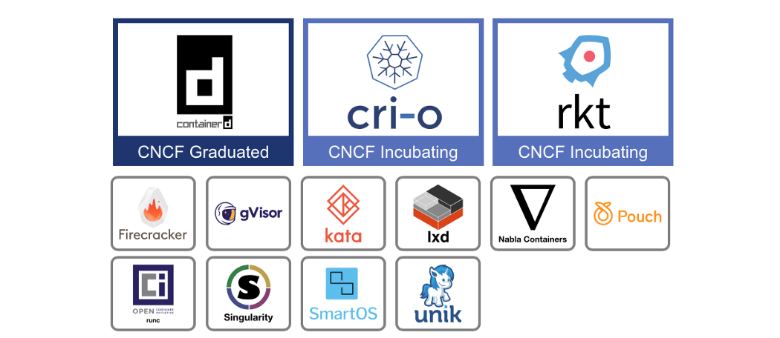
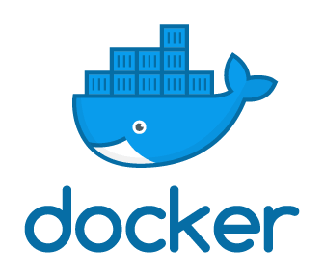
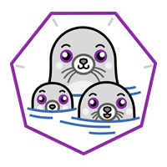
Container Runtimes
(CNCF)
Cloud Native Computing Foundation

Slide 16
Container (Docker) Architecture and core elements
Architecture - Client Server
Client : cli “docker” use restful API communication with Server
Server : docker daemon → * for podman not required daemon
Core Element
Image : Read only template
Registry : Store Images
Container : Segregated user-space environments

Slide 17
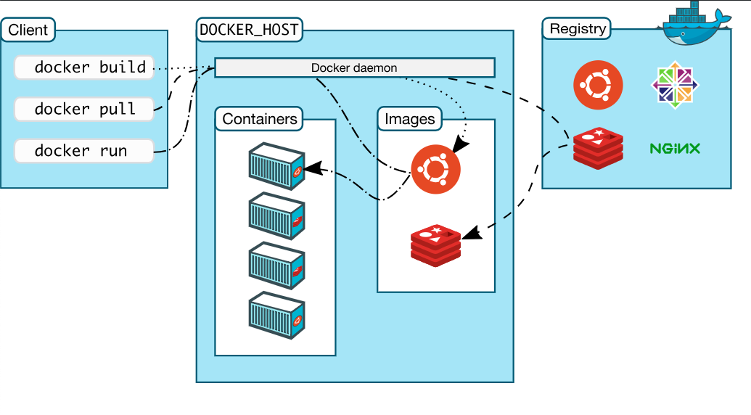
Docker architecture

Slide 18
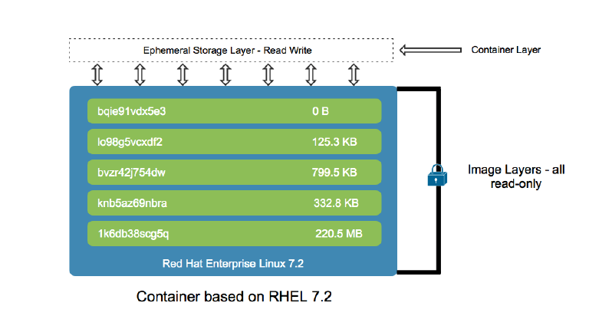
Docker image layers
Notes:
補充
docker unionfs 在 hd 存放位置
docker-storage-setup 的資訊

Slide 19
RAPID SECURITY PATCHING USING CONTAINER IMAGE LAYERING
Image Layer 3
Application Layer
Image Layer 2
Java Runtime Layer
Image Layer 1
OS Update Layer
Base Image
Base RHEL
Container Image Layers
Example Container Image
Notes:
A container image is typically made up of multiple layers.
The first image is called a base image, and it includes everything necessary to get started.Teams often work by building their own layers on these base images. Users can also build on more advanced application images, which not only have an operating system but also include language runtimes, debugging tools, and libraries.
Base images are built from the same utilities and libraries included in an operating system. A good base image provides a secure and stable platform on which to build applications. Red Hat provides base images for Red Hat Enterprise Linux. These images can be used like a normal operating system. Users can customize them as necessary for their applications, installing packages and enabling services to start up just like a normal Red Hat Enterprise Linux Server.
Red Hat also provides more advanced application images that already include extra software. Examples include language runtimes, databases, middleware, storage, and independent software vendor (ISV) software. Software included in these images is tested, pre-configured and certified to work out of the box. These pre-built images make it easy to deploy multi-tier applications from existing components without the work of building your own application images.
The layering structure significantly simplies patching procedures since a layer needs to be patched only once and then any image built using that layer would contain the applied patch
Container platforms like OpenShift have the ability to track existing containers that use a certain layer and if patched, trigger a series of image builds and deploys for existing and running containers in order to apply the patched layer across all containers and prevent security breaches.

Slide 20
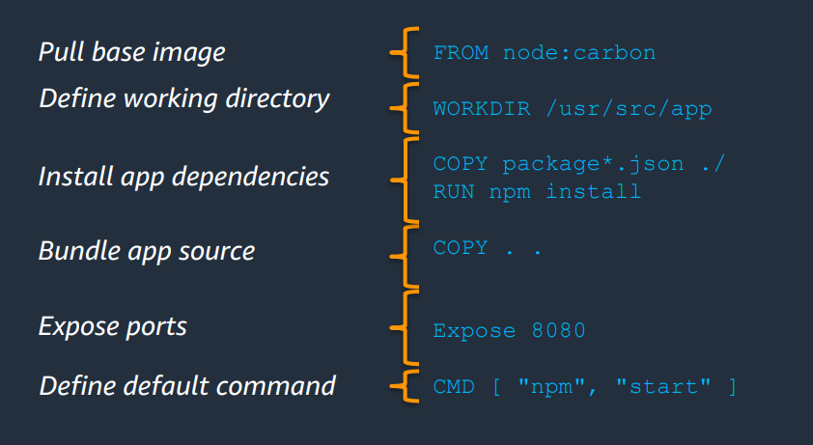
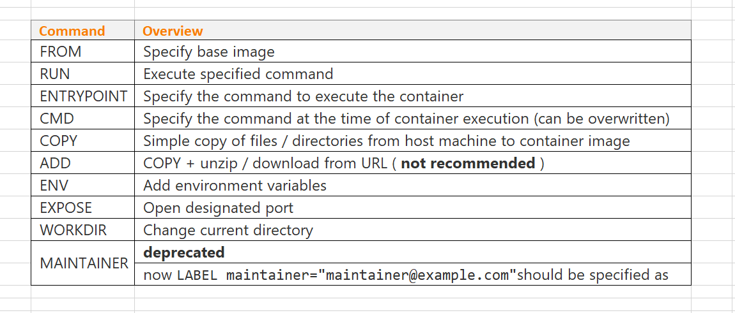
Dockerfile
Dockerfile - imperative DSL that defines build commands
Each docker build command generates SINGLE image layer
Complete docker build execution generates SINGLE Docker image

Slide 21
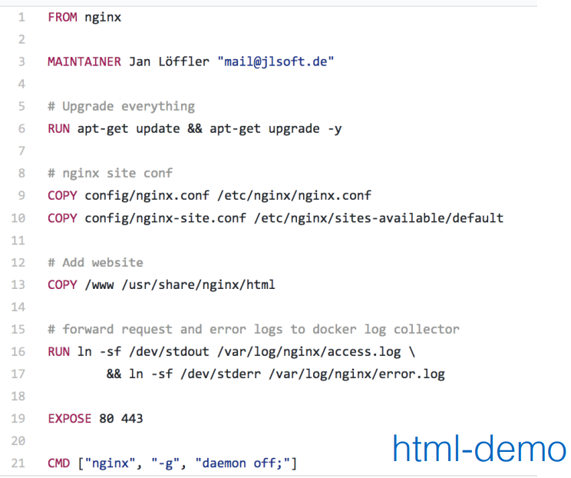
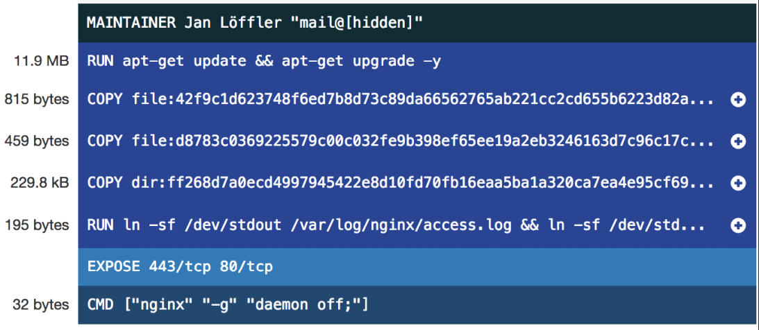
Dockerfile to Image

Slide 22
Image Operation
List this machine images
docker images
Get image - docker
docker pull registry.access.redhat.com/rhel7:latest
Upload image
docker push my.docker-registry.com/rhel7:latest
Create image
docker build -t app:v1 .
docker commit CONTAINER [REPOSITORY[:TAG]]
Save/Load image
docker save -o rhel7.tar registry.access.redhat.com/rhel7:latest
docker load -i rhel7.tar
Tag (alias)
docker tag SOURCE_IMAGE[:TAG] TARGET_IMAGE[:TAG]
Remove image
docker rmi IMAGE
Remove container
docker rm CONTAINER

Slide 23
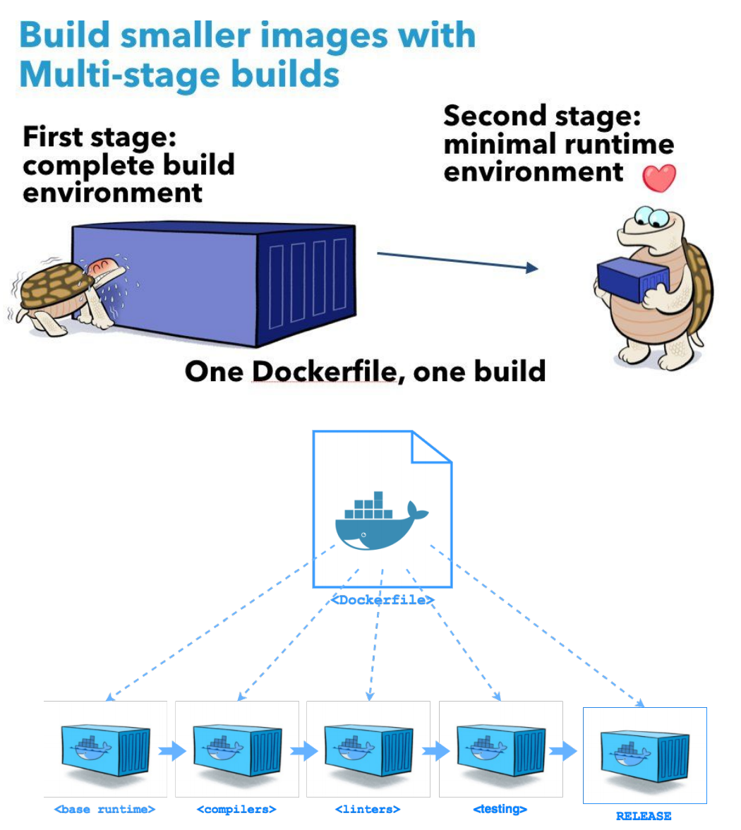
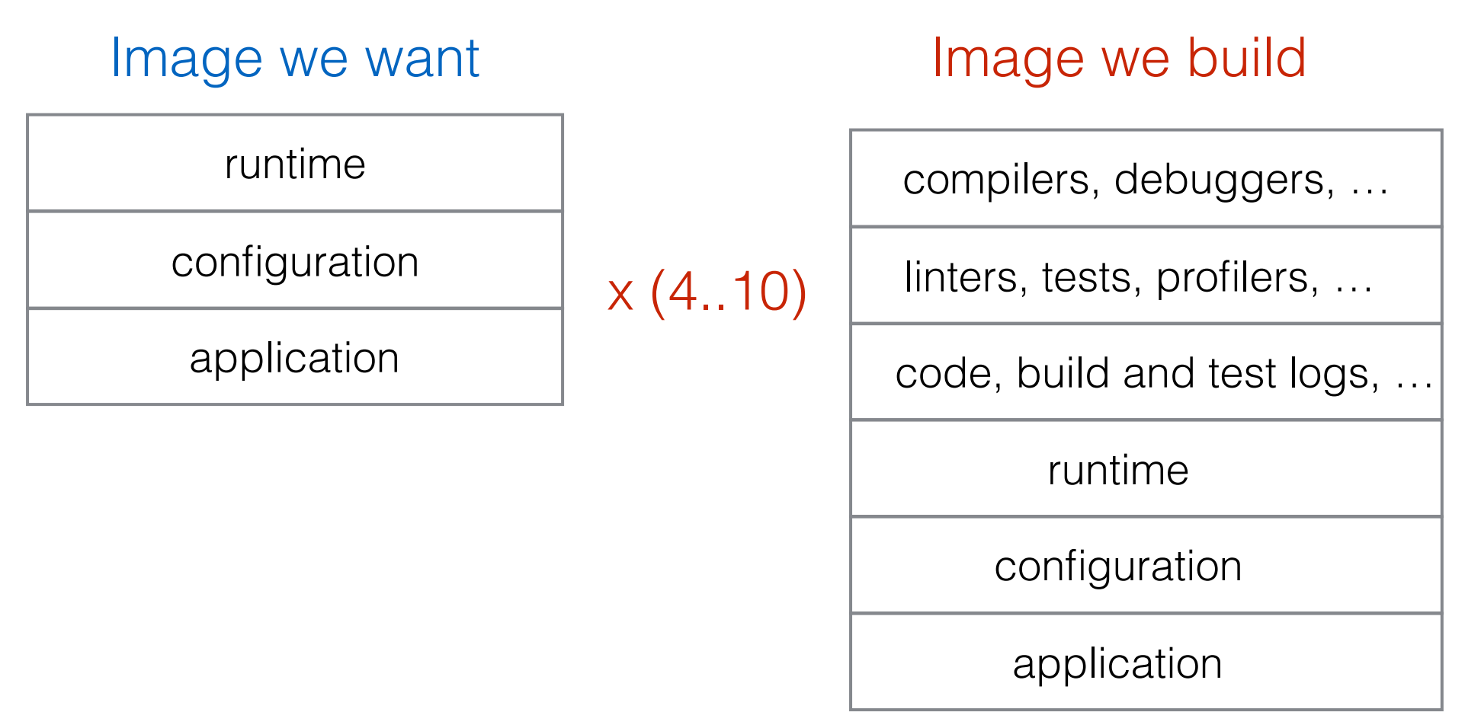
Problem with Docker Build
XXX MB or GB

Slide 24
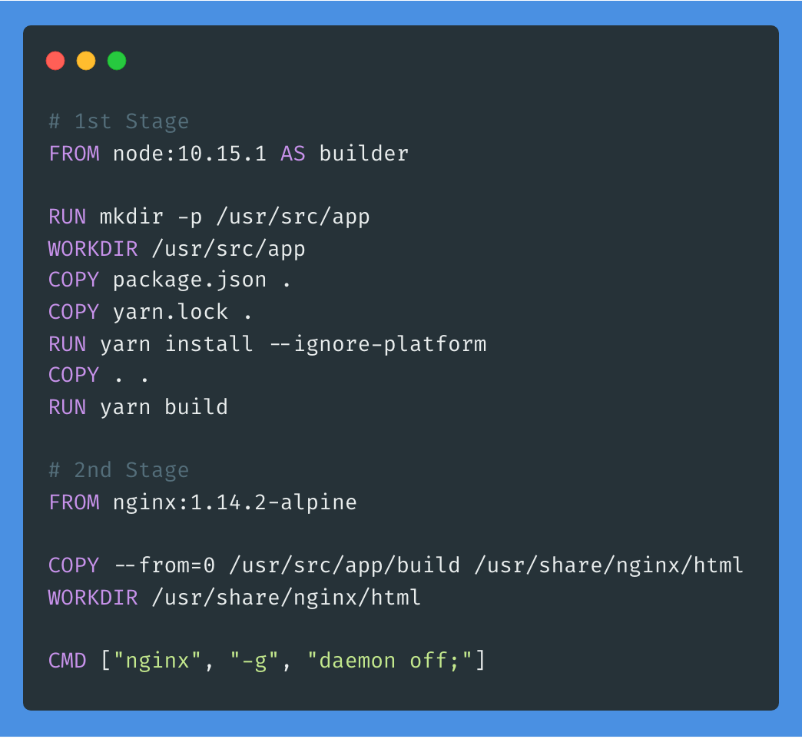
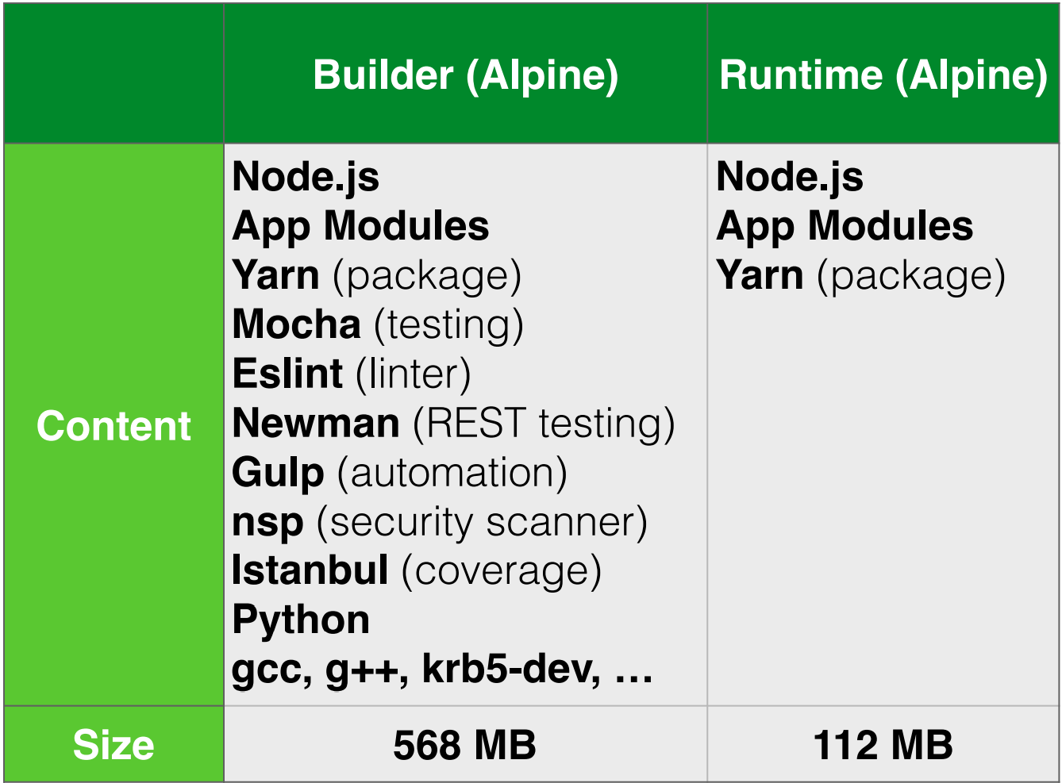
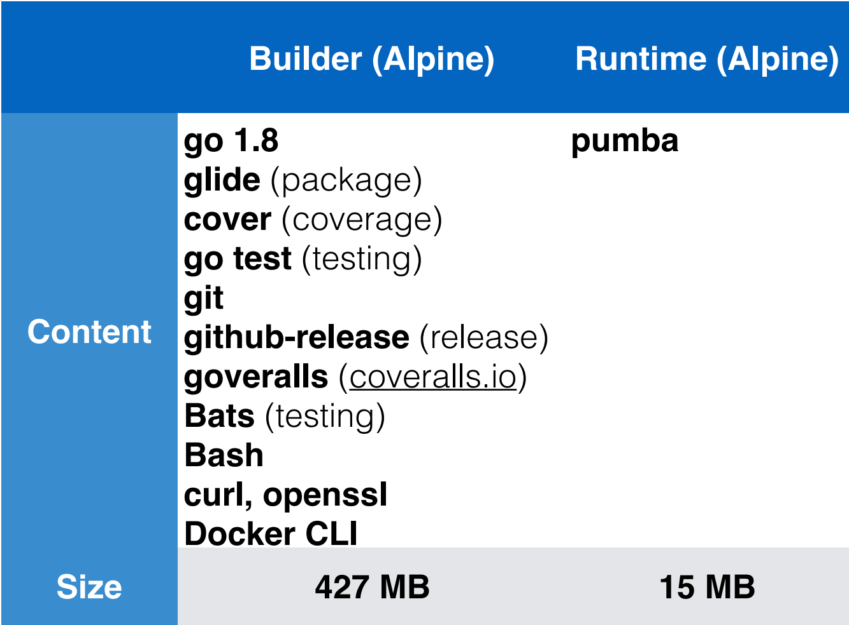
Multi Stage Build Image

Slide 25
an image repository contains all versions of an image in the image registry
IMAGE REGISTRY
myregistry/frontend
myregistry/mongo
frontend:latest
frontend:2.0
frontend:1.1
frontend:1.0
mongo:latest
mongo:3.7
mongo:3.6
mongo:3.4
CONTAINER IMAGE
CONTAINER IMAGE

Slide 26
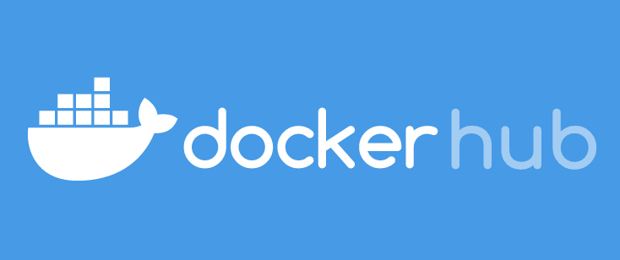

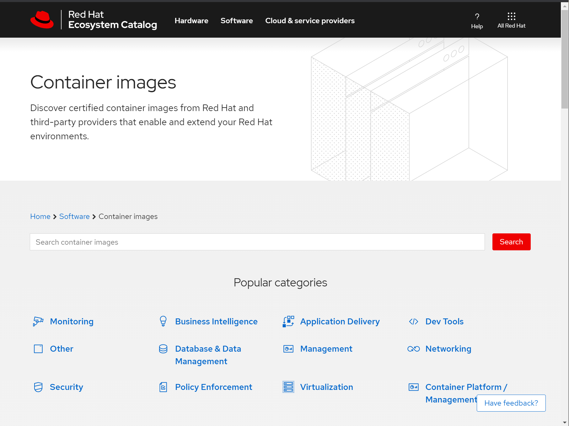
container images are stored in an image registry
IMAGE REGISTRY
CONTAINER IMAGE
CONTAINER IMAGE
CONTAINER IMAGE
CONTAINER IMAGE
CONTAINER IMAGE
CONTAINER IMAGE
Notes:
OpenShift has a built-in image registry to store images and and also deploy from the registry
Upstream registries like Docker Hub and Red Hat registry can also be used with OpenShift. They are in fact by default configured so when an image is not available in the built-in registry, it will be search for in the upstream registries.

Slide 27
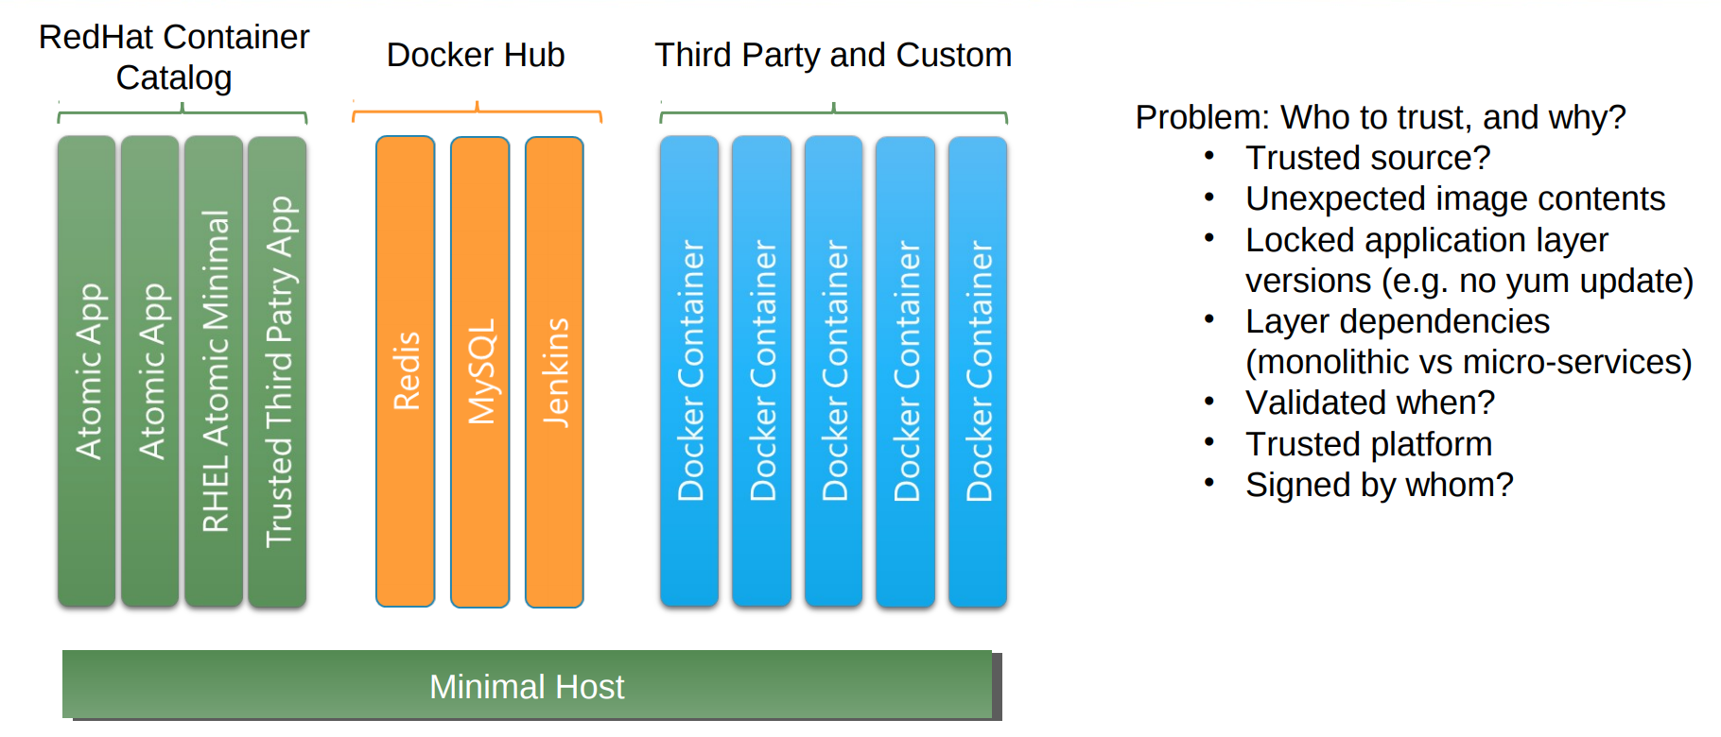
Trust Your Container Source

Slide 28
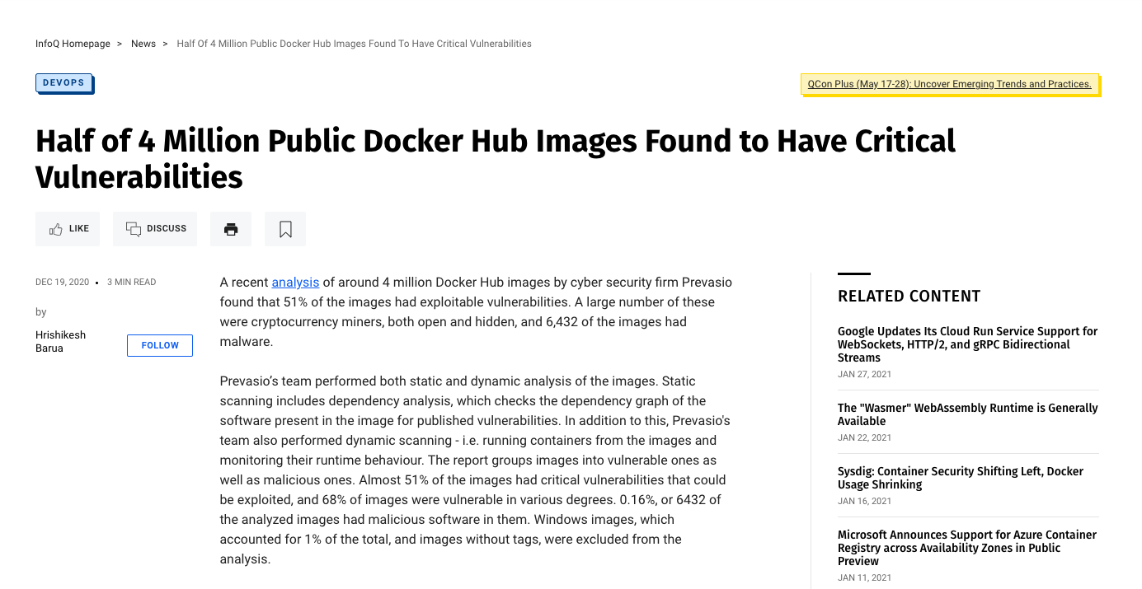
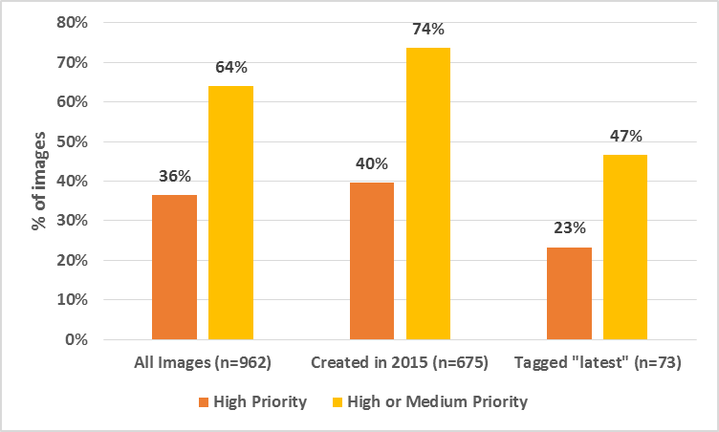
What’s inside the container does matter
64% of official images in Docker Hub contain security vulnerabilities
Example of vulnerabilities:
ShellShock (bash)
Heartbleed (OpenSSL)
Poodle (OpenSSL)
etc.
Source: Over 30% of Official Images in Docker Hub Contain High Priority Security Vulnerabilities, Jayanth Gummaraju, Tarun Desikan, and Yoshio Turner, BanyanOps, May 2015 (http://www.banyanops.com/pdf/BanyanOps-AnalyzingDockerHub-WhitePaper.pdf)

Slide 29
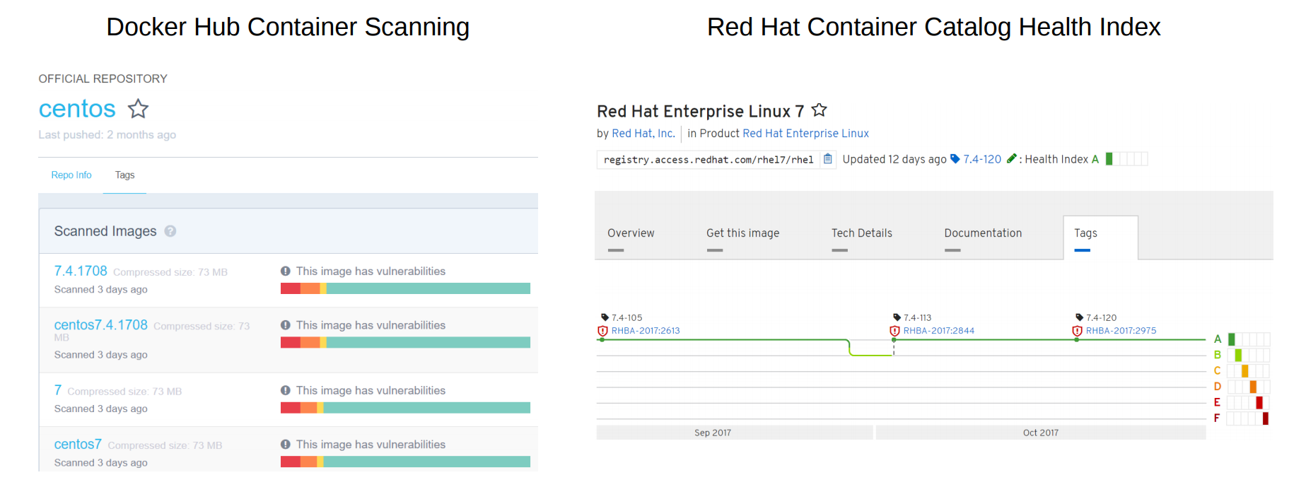
Container Trust Issues
*Docker Hub Pro Only

Slide 30
A container is the smallest compute unit
CONTAINER

Slide 31
containers are created from container images
CONTAINER IMAGE
CONTAINER
BINARY
RUNTIME

Slide 32
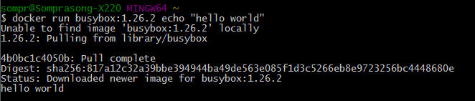
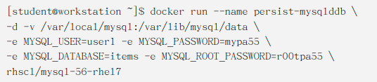
Container Operation
Start Container
docker run
Strop container
docker stop CONTAINER-ID
List all active container
docker ps
View container log
docker logs CONTAINER-ID
Remote container command
docker exec CONTAINER-ID COMMAND
Notes:
Running the image is also simple. A single command and the container process gets started on the host.

Slide 33
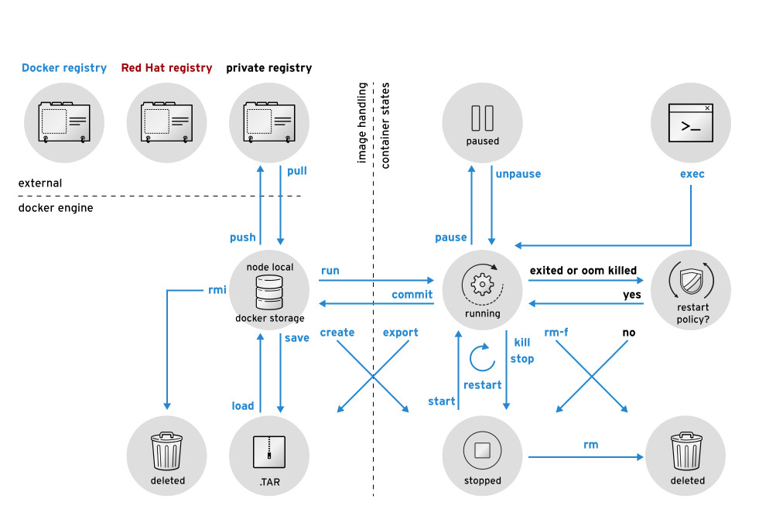
Container Life Cycle

Slide 34
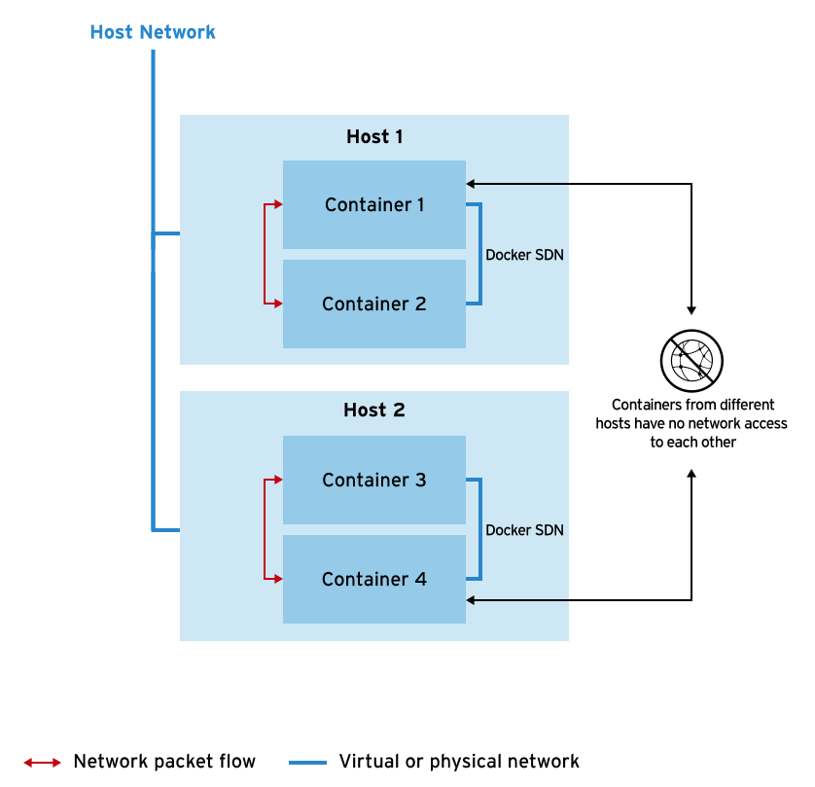
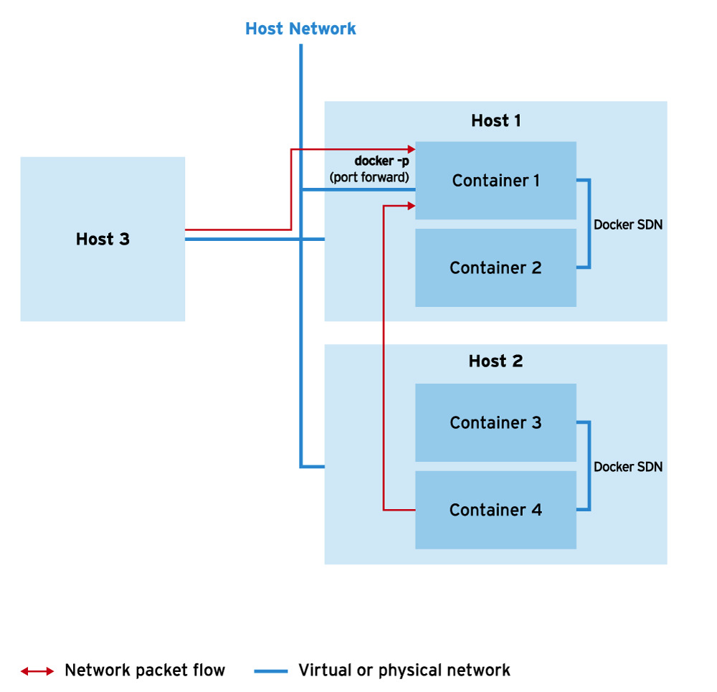
Docker Network
By default, the Docker engine uses a bridged network mode, which through the use of iptables and NAT, allows containers to connect to the host machines network.

Slide 35
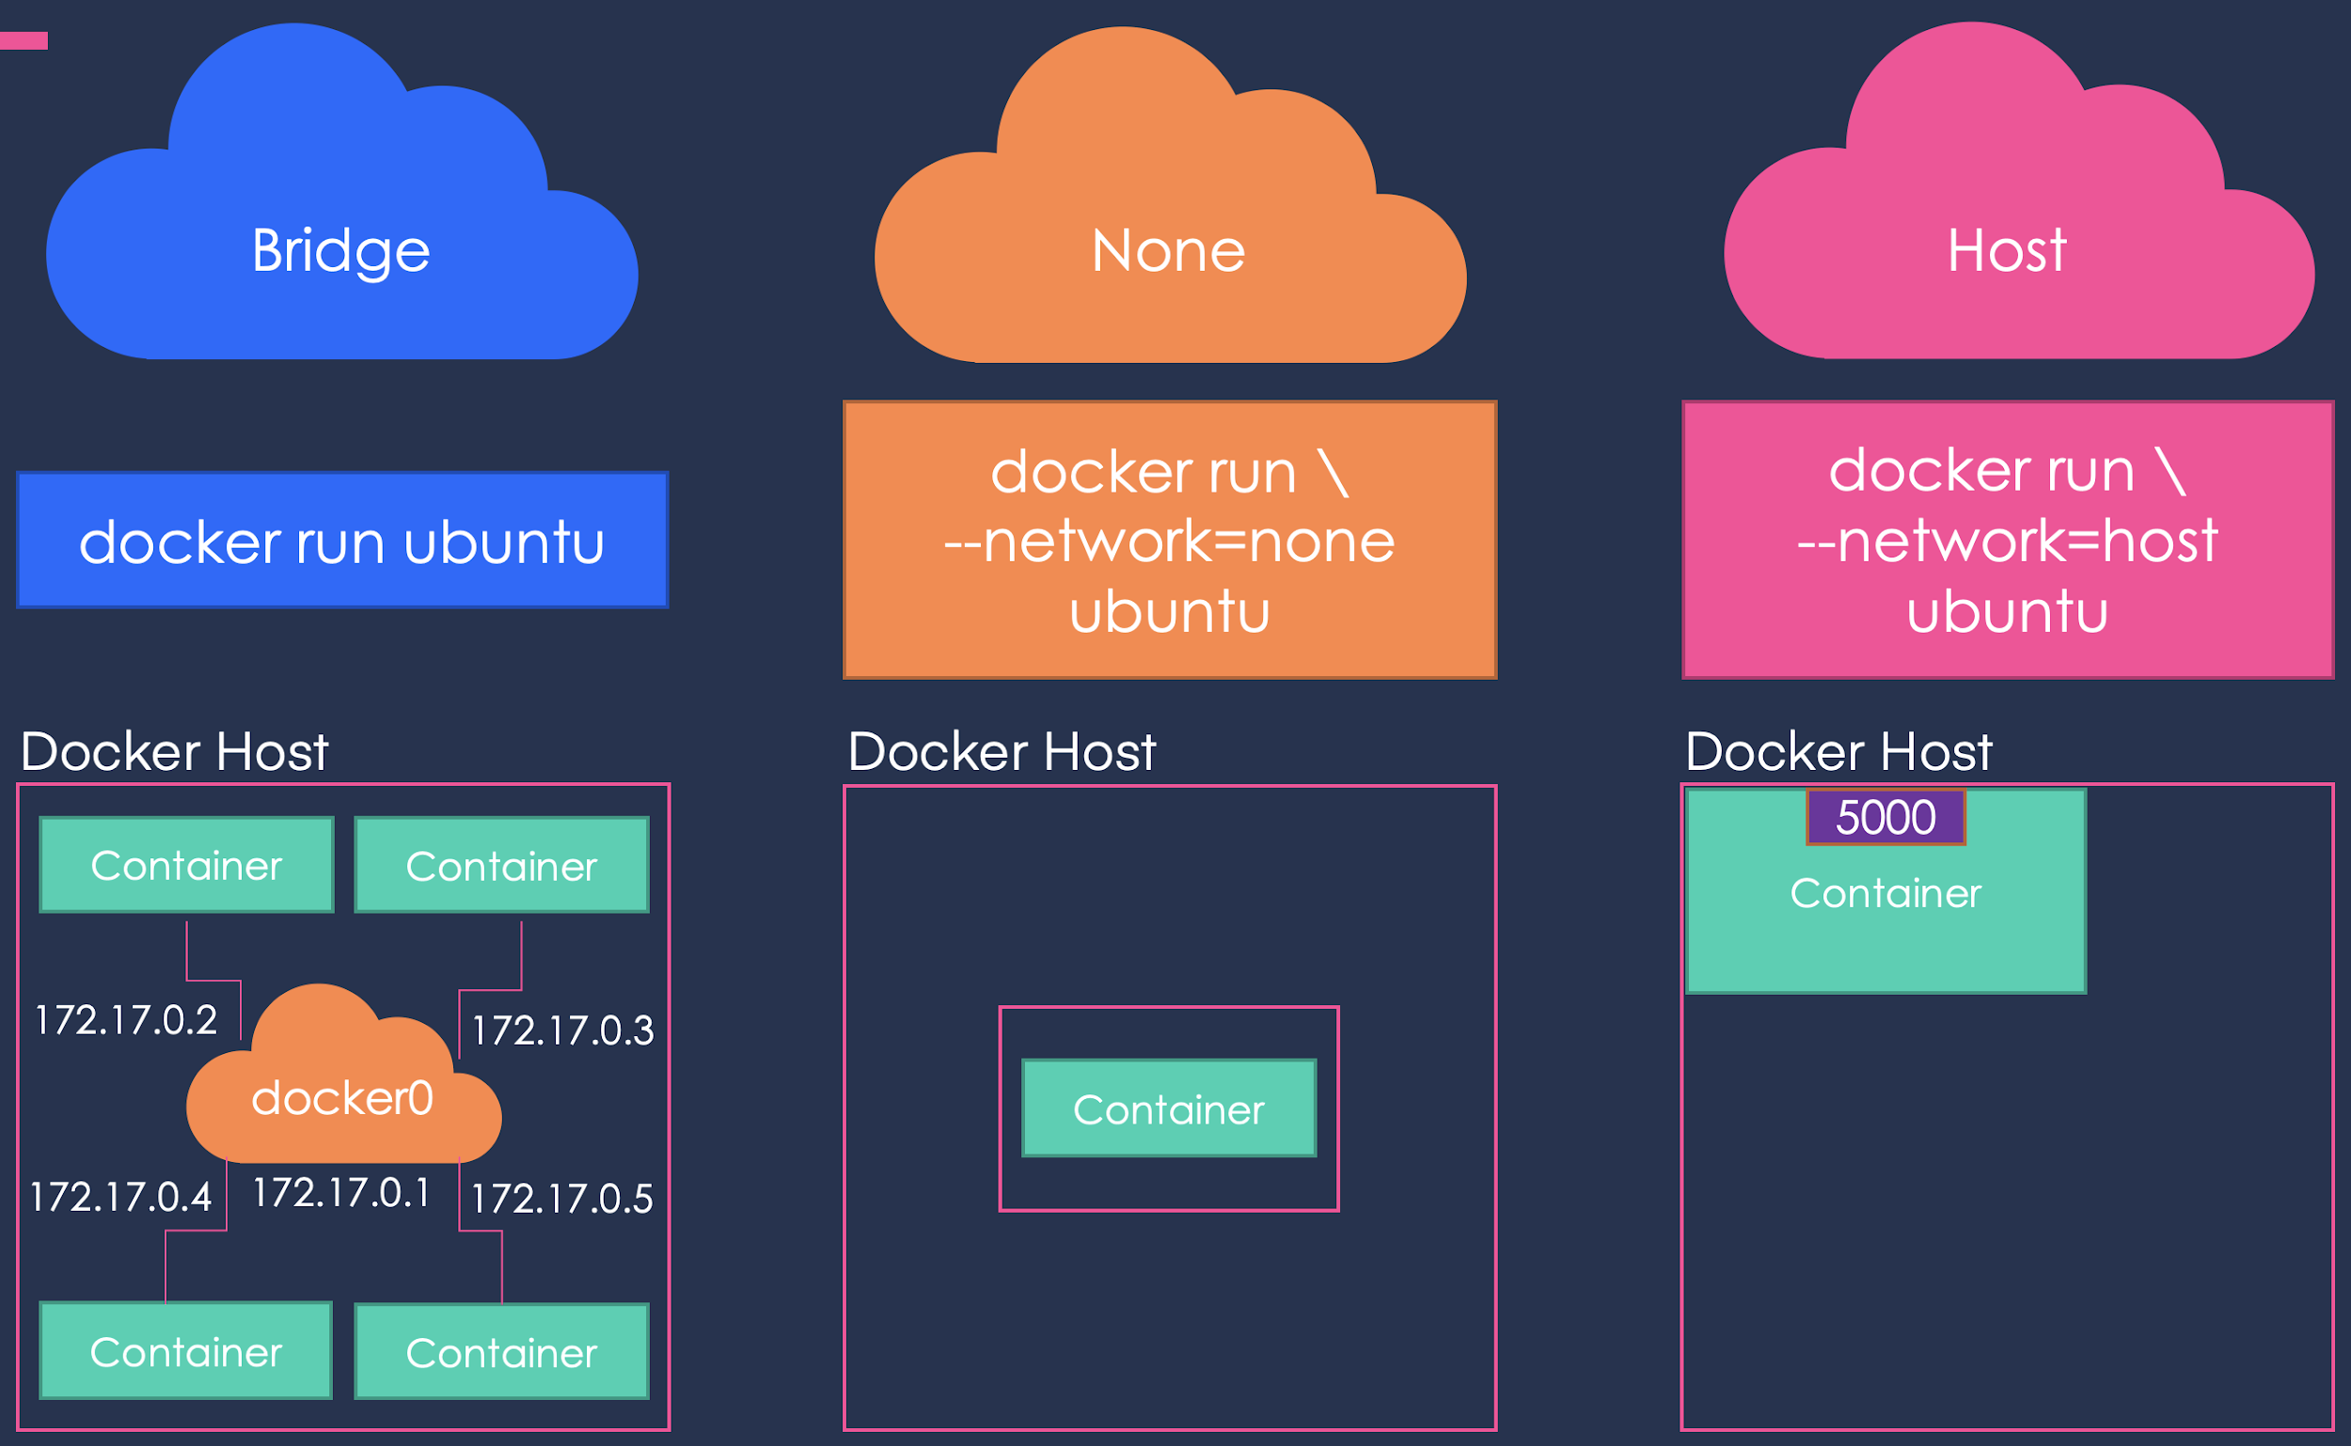
Docker Network
bridge: The default network driver. If you don’t specify a driver, this is the type of network you are creating. Bridge networks are usually used when your applications run in standalone containers that need to communicate.
(for naming/alias user docker run --link option)
host: For standalone containers, remove network isolation between the container and the Docker host, and use the host’s networking directly.
none: For this container, disable all networking. Usually used in conjunction with a custom network driver. none is not available for swarm services.
Overlay: For swarm mode.

Slide 36
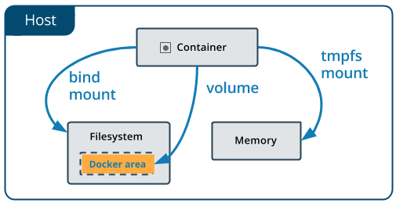
Persist Data
docker run -v /docker/redis-data:/data --name redis -d redis redis-server --appendonly yes
Volumes are stored in a part of the host filesystem which is managed by Docker (/var/lib/docker/volumes/ on Linux). Non-Docker processes should not modify this part of the filesystem. Volumes are the best way to persist data in Docker.
Bind mounts may be stored anywhere on the host system. They may even be important system files or directories. Non-Docker processes on the Docker host or a Docker container can modify them at any time.
tmpfs mounts are stored in the host system’s memory only, and are never written to the host system’s filesystem.

Slide 37
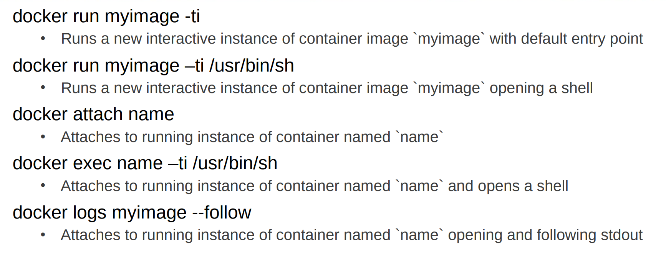
Container Debugging
Notes:
Docker attach : Attach local standard input, output, and error streams to a running container

Slide 38
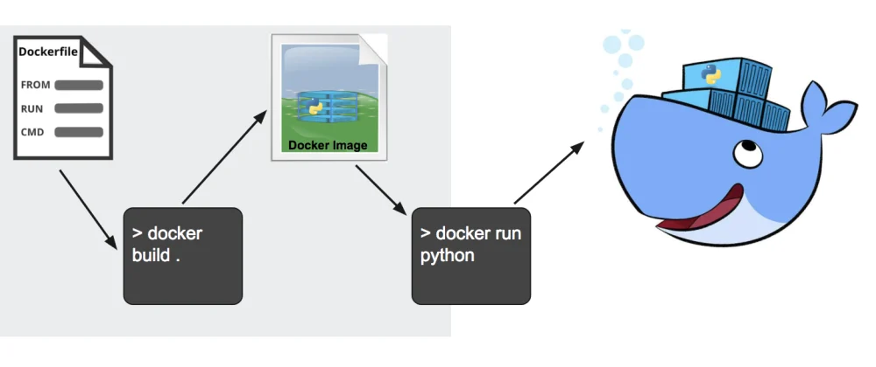
Operation Per Container
Build image from Dockerfile
Pull image from Hub/Registry
Configure and Create container
Start and stop container
Stream their logs

Slide 39
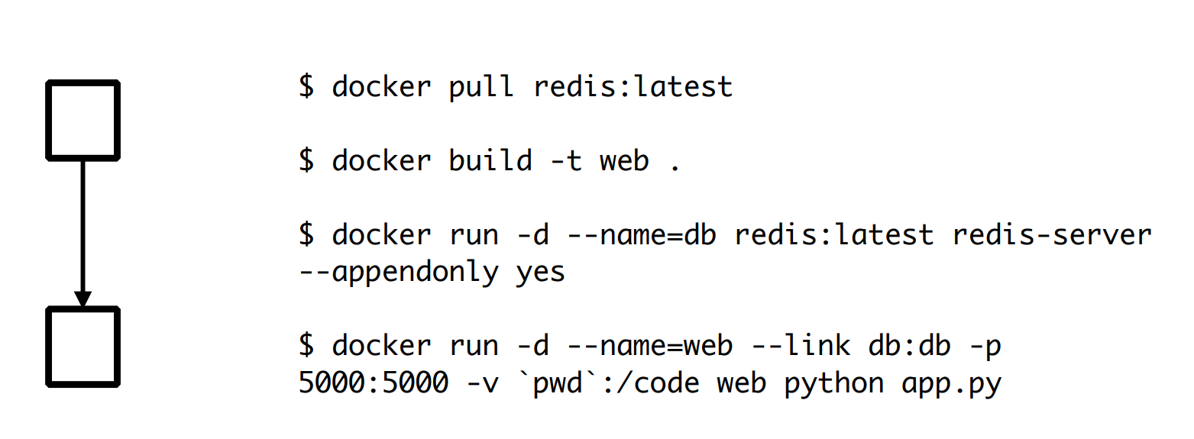
Multi-Container

Slide 40
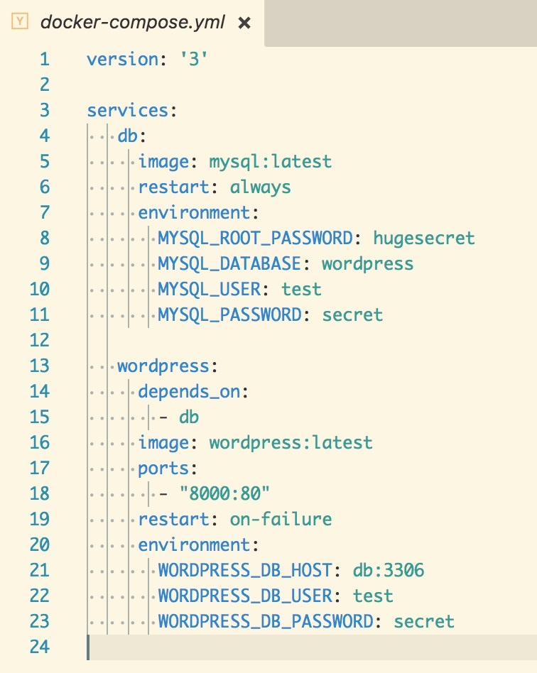
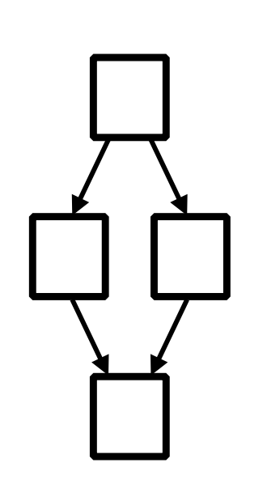
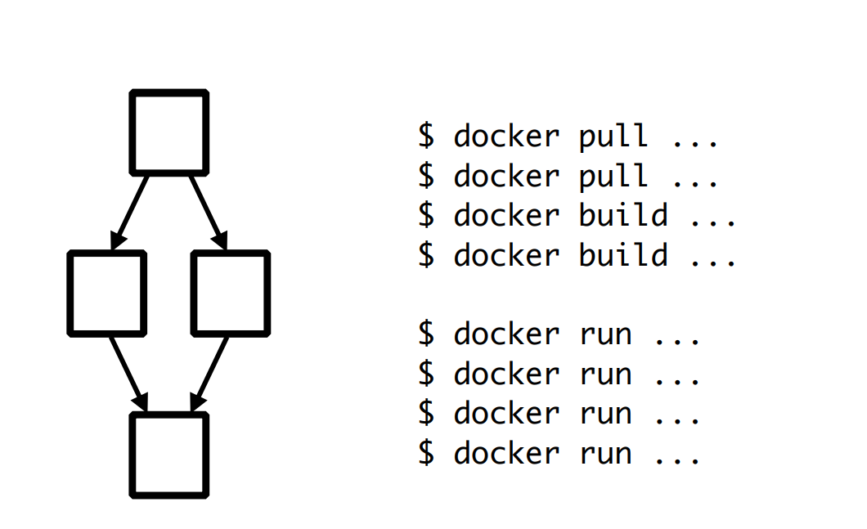
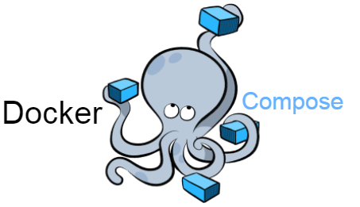
Multi-Container
docker-compose up

Slide 41
Demo
Resource: https://github.com/chatapazar/demo-container.git

Slide 42
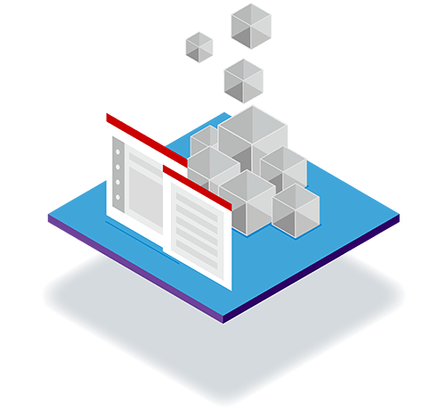
Benefits of Containers
Containers are a streamlined way to build, test, deploy, and redeploy applications on multiple environments from a developer’s local laptop to an on-premises data center and even the cloud. Benefits of containers include:
Less overhead Containers require less system resources than traditional or hardware virtual machine environments because they don’t include operating system images.
Increased portability Applications running in containers can be deployed easily to multiple different operating systems and hardware platforms.
More consistent operation DevOps teams know applications in containers will run the same, regardless of where they are deployed.
Greater efficiency Containers allow applications to be more rapidly deployed, patched, or scaled.
Better application development Containers support agile and DevOps efforts to accelerate development, test, and production cycles.

Slide 43

Best Practices for Dev Container Apps
Keep Application Configuration Outside Container Image
Specify Resources request and limit in Container Definition
Always define Liveness and Readiness Probe
Ensure that Container Terminate Gracefully
Implement Application Monitoring And Alert

Slide 44
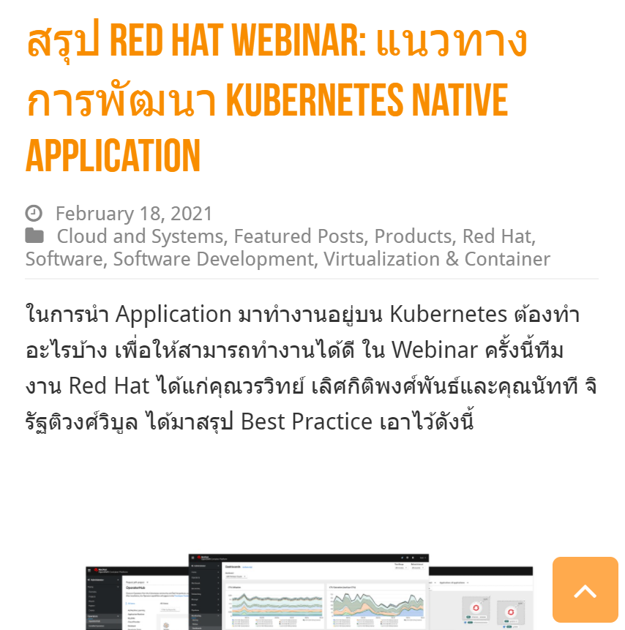

Best Practices for Dev Container Apps (cont’)
Configure the applications to write their logs to stdout/stderr
Run one Process Per Container
Use Trusted Base Container & Latest Version
Use a Separate Build Image and Runtime Image
https://www.techtalkthai.com/red-hat-webinar-kubernetes-native-application-development-best-practice-summary/

Slide 45
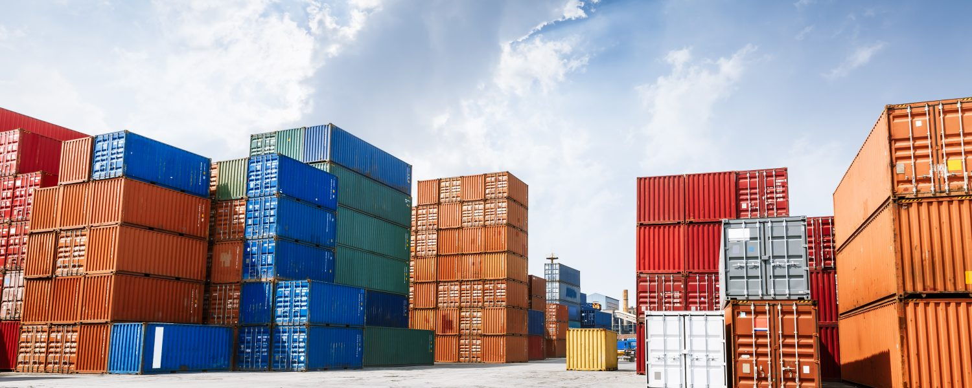

Operation Per Container
For Multiple Container….
Build image from Dockerfile
Pull image from Hub/Registry
Configure and Create container
Start and stop container
Stream their logs
Persistent
Network
etc.

Slide 46
Thank you
RED HAT SERVICES JOURNEY

